Slide 1
ENGI 301 “Loss Prevention Device” Proposal
October 4, 2020
Spencer Wong

Slide 2
Background Information
This “Loss Prevention Device” (name subject to change) is an electronic device that will alert the user when an object of interest leaves their vicinity
The distance in which the user gets an alert can be modified depending on the application
The main way of measuring distance will be utilizing a Bluetooth Low Energy Beacon
Methods of alerting the user may include sending the user a text or a phone call (using the internet)
The location where which the alert is sent will be recorded
Uses:
Keeping track of children in a crowded place
Making sure you don’t forget child in a hot car, etc
Prevent stealing
Notes:
What is being proposed?
Pictures
Links to existing projects / libraries
What improvements / additions over existing project

Slide 3
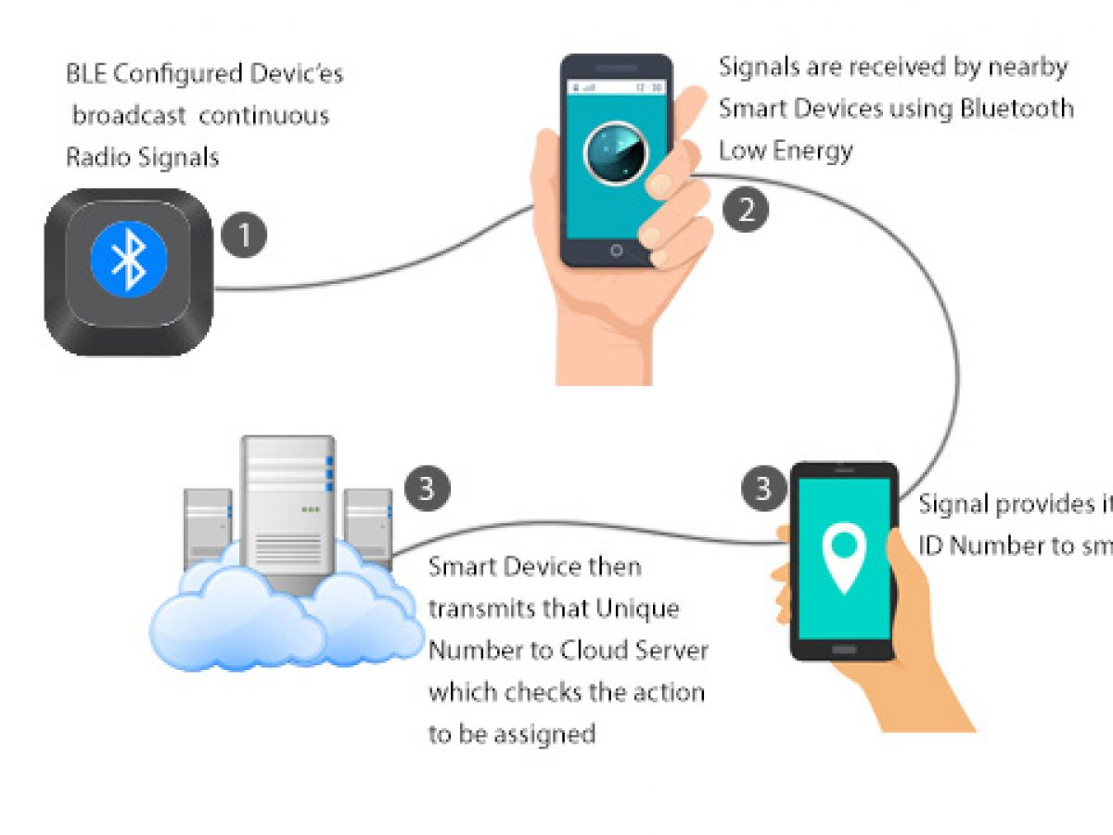
Background Information
Bluetooth Low Energy Beacons -- https://en.wikipedia.org/wiki/Bluetooth_low_energy_beacon#Advertising
AltBeacon – open source BLEB: https://github.com/AltBeacon
Utilizes phone
E.g. if a person walks into a store they get a notification from the store
Use BLE sensor connected with pocketbeagle to connect with phone
When one goes too far away from the other, the phone is alerted
BLE sensor: DSD TECH HM-10
Notes:
What is being proposed?
Pictures
Links to existing projects / libraries
What improvements / additions over existing project

Slide 4
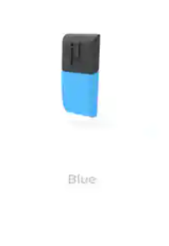
Background Information
Existing solution: Mu tag (https://www.kickstarter.com/projects/869417908/mu-tag-worlds-smallest-loss-prevention-device/description?utm_source=thisiswhyimbroke.com&utm_medium=referral)
Uses app
Tiny and Chargeable
“ibeacon technology” – Apple’s BLE Technology
Various ways to attach to things
Charge for 40 min, lasts 3 weeks
Sends a notification
Notes:
What is being proposed?
Pictures
Links to existing projects / libraries
What improvements / additions over existing project

Slide 5
Background Information
Ways I can improve/change the tracking device:
Using calls/texts to notify user, no phone app
Can be powered externally
***More modifiable depending on the application
PB sources:
https://www.digikey.com/en/articles/how-to-make-a-beaglebone-based-appliance-notification-texter - Guide for text alerts
https://www.teachmemicro.com/pocketbeagle-wifi/ - Guide for adding wifi
How to relocate device?
GPS (Useful info: https://drive.google.com/file/d/1dSdSLoo4JpHFd8qM0BEkE5fvYLP2yZlh/view)
GPS Module: GT-U7
LEDs/Speaker if desired
I will be prototyping with WiFi, but a cellular modem can be used in the future
Notes:
What is being proposed?
Pictures
Links to existing projects / libraries
What improvements / additions over existing project

Slide 6
System Block Diagram
Pocketbeagle
DSD TECH HM-10
Bluetooth
RX
Smart Phone
UART0
TX
RX
GT-U7
UART2
TX
Internet Source (probably a WiFi adapter)
USB1
MicroUsb Power Source (Car charger, battery, etc)
MicroUSB
Notes:
Create a System Block Diagram
Label interfaces / pins
Components (part numbers if possible)

Slide 7
Power Block Diagram
Pocketbeagle
5 Volts
Vout
DSD TECH HM-10
GT-U7
Internet Source (probably a WiFi adapter)
USB1
MicroUsb Power Source (Car charger, battery, etc)
MicroUSB
Notes:
Create a Power Block Diagram
Label voltages / currents of components

Slide 8
Components / Budget
Component | Need to Buy | Cost
Bluetooth Beacon (https://www.amazon.com/DSD-TECH-Bluetooth-iBeacon-Arduino/dp/B06WGZB2N4/ref=sr_1_10?dchild=1&keywords=Bluetooth+Beacon&qid=1601861152&sr=8-10) | 1 | $9.99
GPS Module (https://www.amazon.com/Microcontroller-Compatible-Sensitivity-Navigation-Positioning/dp/B07P8YMVNT/ref=sr_1_3?dchild=1&keywords=GPS+module&qid=1602041167&sr=8-3) | 1 | $12.99
WiFi Adapter – Provided

